Slide 1
Exception Handling
Lecture 6

Slide 2
Exception Handling in .net
Exceptions are types that all ultimately derive from System.Exception.
Use a try block around the statements that might throw exceptions.
Once an exception occurs in the try block, the flow of control jumps to the first associated exception handler that is present anywhere in the call stack. In C#, the catch keyword is used to define an exception handler.
If no exception handler for a given exception is present, the program stops executing with an error message.

Slide 3
Syntax
try {
// code that requires common cleanup or
// exception-recovery operations
}
catch (InvalidOperationException) {
//code that recovers from an InvalidOperationException
// (or any exception type derived from it)
}
catch (SomeOtherException) {
// code that recovers from an SomeOtherException
// (or any exception type derived from it)
}
catch {
// code that recovers from any kind of exception
// when you catch any exception, you usually re-throw
throw;
}
finally {
// code that cleans up any operations started
// within the try block. This code ALWAYS executes.
}

Slide 4
try block
A try block contains code that requires common cleanup or exception-recovery operations.
The cleanup code should be put in a single finally block.
The exception recovery code should be put in one or more catch blocks.
Create one catch block for each kind of type you want to handle.
A try block must have at least one catch or finally block.

Slide 5
catch block
A catch block contains code to execute in response to an exception.
If the code in a try block doesn’t cause an exception to be thrown, the CLR will never execute the code in any of its catch blocks.
You may or may not specify a catch type in parantheses after catch :
The catch type must be of type System.Exception or a type that derived from System.Exception
If there is no catch type specified, that catch block handles any exception. This is equivalent to having a catch block that specifies System.Exception as a catch type.
CLR searches for a matching catch type from top to bottom.
If CLR cannot find any catch type that matches the exception, CLR continues searching up the callstack to find a catch type.

Slide 6
Once the catch block that matches the exception is found, you have 3 choices:
Re-throw the same exception
Throw a different exception, giving richer exception information to code.
Let the code continue from the bottom of the catch block
In choices 1-2, an exception is thrown and code starts looking for a catch block whose type matches the exception thrown
In choice 3, the finally block is executed
You can also specify a variable name like catch(Exception e) to access information specific to the exception.

Slide 7
finally block
GC does automatic memory clean-up, it only cleans up if there are no references kept on the object.
Thus, memory leaks can occur if programmers carelessly keep references to unwanted objects.
C# provides the finally block, which is guaranteed to execute regardless of whether an exception occurs.
If the try block executes without throwing, the finally block executes.
If the try block throws an exception, the finally block still executes regardless of whether the exception is caught.
This makes the finally block ideal to release resources from the corresponding try block.

Slide 8
Exception Classes in C#
C# exceptions are represented by classes. The exception classes in C# are mainly directly or indirectly derived from the System.Exception class. Some of the exception classes derived from the System.Exception class are the System.ApplicationException and System.SystemException classes.
The System.ApplicationException class supports exceptions generated by application programs. So the exceptions defined by the programmers should derive from this class.
The System.SystemException class is the base class for all predefined system exception.

Slide 9
System.Exception Properties
Class Exception’s properties are used to formulate error messages indicating a caught exception.
Property Message stores the error message associated with an Exception object.
Property StackTrace contains a string that represents the method-call stack.
When an exception occurs, a programmer might use a different error message or indicate a new exception type.
The original exception object is stored in the InnerException property.
Other properties:
HelpLink specifies the location of a help file that describes the problem.
Source specifies the name of the application or object that caused the exception.
TargetSite specifies the method where the exception originated.

Slide 10
Defined Exception
Exception Class | Description
System.IO.IOException | Handles I/O errors.
System.IndexOutOfRangeException | Handles errors generated when a method refers to an array index out of range.
System.ArrayTypeMismatchException | Handles errors generated when type is mismatched with the array type.
System.NullReferenceException | Handles errors generated from deferencing a null object.
System.DivideByZeroException | Handles errors generated from dividing a dividend with zero.
System.InvalidCastException | Handles errors generated during typecasting.
System.OutOfMemoryException | Handles errors generated from insufficient free memory.
System.StackOverflowException | Handles errors generated from stack overflow.

Slide 11
Conversion and Formatting
.NET Provides Variety of Mechanism
ToString and Parse
These methods provide default functionality for many types
FormatProviders
These manifest as additional ToString (and Parse) methods that accept a format string and/or a format provider. Format providers are highly flexible and cultureaware. The .NET Framework includes format providers for the numeric types and DateTime/DateTimeOffset.
XMLConvert
This is a static class with methods that format and parse while honoring XML standards. XmlConvert is also useful for general-purpose conversion when you need culture independence or you want to preempt misparsing. XmlConvert supports the numeric types, bool, DateTime, DateTimeOffset, TimeSpan, and Guid.
Type Converters
These target designers and XAML parsers.

Slide 12
ToString and Parse
Parse can have 2 possible commands
Parse()
TryParse()
ToString can accept CultureInfo.
The most commonly used CultureInfo.InvariantCulture
In Germany 1.234 is 1 234, because they perceive dot as thousand separator
So to fix this we can do
Parse(“1.234”, CultureInfo.InvariantCulture);
ToString(CultureInfo.InvariantCulture);

Slide 13
Format Providers
The gateway to using a format provider is IFormattable. All numeric types—and DateTime(Offset)—implement this interface:
public interface IFormattable
{
string ToString (string format, IFormatProvider formatProvider);
}
The first argument is the format string; the second is the format provider. The format string provides instructions; the format provider determines how the instructions are translated.
NumberFormatInfo f = new NumberFormatInfo();
f.CurrencySymbol = "$$";
Console.WriteLine (3.ToString ("C", f)); // $$ 3.00

Slide 14
Format Providers
If you specify a null format string or provider, a default is applied. The default format provider is CultureInfo.CurrentCulture, which, unless reassigned, reflects the computer’s runtime control panel settings.
We can create culture info object of any region
CultureInfo uk = CultureInfo.GetCultureInfo ("en-GB");
Console.WriteLine (3.ToString ("C", uk)); // 3.00

Slide 15
NumberFormatInfo and DateFormatInfo
Change dot separator of grouping to space:
NumberFormatInfo f = new NumberFormatInfo ();
f.NumberGroupSeparator = " ";
Console.WriteLine (12345.6789.ToString ("N3", f)); // 12 345.679
Cloning existing to modify some arguments:
NumberFormatInfo f = (NumberFormatInfo) CultureInfo.CurrentCulture.NumberFormat.Clone();

Slide 16
IFormatProvider and ICustomFormatter
By implementing IFormatProvider—along with ICustomFormatter—you can also write your own format provider that works in conjunction with existing types.

Slide 17
The following custom format provider writes numbers as words
public class WordyFormatProvider : IFormatProvider, ICustomFormatter
{
static readonly string[] _numberWords =
"zero one two three four five six seven eight nine minus point".Split();
IFormatProvider _parent; // Allows consumers to chain format providers
public WordyFormatProvider () : this (CultureInfo.CurrentCulture) { }
public WordyFormatProvider (IFormatProvider parent)
{
_parent = parent;
}
public object GetFormat (Type formatType)
{
if (formatType == typeof(ICustomFormatter)) return this;
return null;
}
public string Format (string format, object arg, IFormatProvider prov)
{
// If it's not our format string, defer to the parent provider:
if (arg == null || format != "W")
return string.Format (_parent, "{0:" + format + "}", arg);
StringBuilder result = new StringBuilder();
string digitList = string.Format (CultureInfo.InvariantCulture,
"{0}", arg);
foreach (char digit in digitList)
{
int i = "0123456789-.".IndexOf (digit);
if (i == −1) continue;
if (result.Length > 0) result.Append (' ');
result.Append (_numberWords[i]);
}
return result.ToString();
}
}

Slide 18
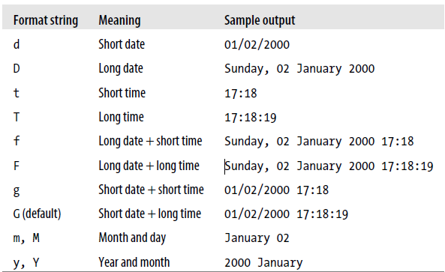
DateTime Formatting Strings

Slide 19
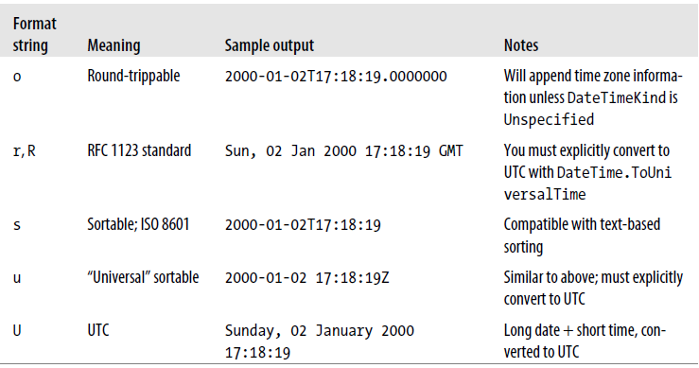
DateTime Formatting Strings (More)

Slide 20
EXAMPLE
DateTime date1 = new DateTime(2008, 4, 10, 6, 30, 0);
Console.WriteLine(date1.ToString("F",
CultureInfo.CreateSpecificCulture("en-US")));
// Displays Thursday, April 10, 2008 6:30:00 AM
Console.WriteLine(date1.ToString("F",
CultureInfo.CreateSpecificCulture("fr-FR")));
// Displays jeudi 10 avril 2008 06:30:00

Slide 21
CUSTOM DATETIME FORMATTING
DateTime thisDate1 = new DateTime(2011, 6, 10);
Console.WriteLine("Today is " + thisDate1.ToString("MMMM dd, yyyy") + ".");
DateTimeOffset thisDate2 = new DateTimeOffset(2011, 6, 10, 15, 24, 16,
TimeSpan.Zero);
Console.WriteLine("The current date and time: {0:MM/dd/yy H:mm:ss zzz}",
thisDate2);
// The example displays the following output:
// Today is June 10, 2011.
// The current date and time: 06/10/11 15:24:16 +00:00
To Address the full variances of custom formatting try to google next:
Custom Date and Time Format Strings

Slide 22
Convert class
Convert to the different base
int thirty = Convert.ToInt32 ("1E", 16); // Parse in hexadecimal
uint five = Convert.ToUInt32 ("101", 2); // Parse in binary
You can easily use base to convert from HEX,OCT,BIN into DEC and vice versa

Slide 23
Dynamic conversions and Base64
public static object ChangeType (object value, Type conversionType);
Type targetType = typeof (int);
object source = "42";
object result = Convert.ChangeType (source, targetType);
Console.WriteLine (result); // 42
Console.WriteLine (result.GetType()); // System.Int32
Base 64 conversions (byte array)
ToBase64String
FromBase64String

Slide 24
BigInteger
The BigInteger struct is a specialized numeric type introduced in .NET Framework 4.0. It lives in the new System.Numerics namespace in System.Numerics.dll and allows you to represent an arbitrarily large integer without any loss of precision.
BigInteger googol = BigInteger.Pow (10, 100);
BigInteger overloads all the arithmetic operators including remainder (%), as well as the comparison and equality operators.

Slide 25
You can also construct a BigInteger from a byte array. The following code generates a 32-byte random number suitable for cryptography and then assigns it to a BigInteger:
// System.Security.Cryptography namespace:
RandomNumberGenerator rand = RandomNumberGenerator.Create();
byte[] bytes = new byte [32];
rand.GetBytes (bytes);
var bigRandomNumber = new BigInteger (bytes);
// Convert to BigInteger
The advantage of storing such a number in a BigInteger over a byte array is that you get value-type semantics. Calling ToByteArray converts a BigInteger back to a byte array.

